Slide 1
Network Scanning Tool
Presented By:
Shubh Patel (210303126042)
Prarthan Christian (210303126058)
Kartikay Mistry (210303126060)
Krenil Raj (210303126010)
Guided By:
Faculty Name: DR. MOHAMMAD SHAHNAWAZ SHAIKH
Associate Professor
CSE Department
PIET, Parul University
Internal Project Presentation September, 2024

Slide 2
Content
Introduction
Problem Statement
Research Paper Summary (in Tabular form)
Project Team : Roles and Responsibilities
Project Goal and Objectives
Flowchart of the system
Implementation Details
Demonstration of the Project
Testing
Conclusion
Future Work
References
Project Presentation 2024

Slide 3
Introduction
In the realm of cybersecurity and network management, the ever-growing complexity of digital landscapes necessitates robust tools for understanding, securing, and optimizing network infrastructures. Our Network Scanning Tool is a sophisticated solution designed to empower administrators and security professionals in comprehensively assessing and managing computer networks.
The tool provides essential functionalities such as Port Scanning, enabling users to identify networked devices and understand the services running on them. With an emphasis on Service Identification and Vulnerability Assessment, our tool allows for the proactive detection and analysis of potential security risks
Project Presentation 2024

Slide 4
Problem Statement
In today's complex digital environments, organizations face significant challenges in securing and managing their network infrastructures. The increasing number of networked devices and services creates potential vulnerabilities that can be exploited by attackers. Traditional security measures often fail to provide adequate visibility into the network, making it difficult for administrators to proactively detect and mitigate threats.
The need for a comprehensive solution that can efficiently discover hosts, scan ports, identify services, and assess vulnerabilities is critical to strengthening network security. Without such tools, organizations risk network downtime, data breaches, and compliance issues, leading to financial and reputational damage.
This project addresses these challenges by developing an advanced network scanning tool that enables administrators and security professionals to effectively assess and secure their networks through robust host discovery, port scanning, service identification, and vulnerability assessment functionalities.
Project Presentation 2024

Slide 5
Summary
Sr. number | Paper Title | Publisher | Year | Take-away points
1 | Difference between Intrusion Detection System (IDS) and Intrusion Prevention System (IPS). [1] | 1 Pune University, Department Computer Science, India 2 Pune university, Department Statistics, India | 2011 | IDS detects and alerts on suspicious network activity, while IPS actively blocks threats in real-time, offering a proactive security measure. IDS is reactive, whereas IPS is proactive in mitigating attacks.
2 | Intrusion Prevention/Intrusion Detection System (IPS/IDS) FOR WIFI NETWORKS. [2] | IJCNC | 2014 | IPS/IDS for Wi-Fi networks enhances security by monitoring and preventing wireless-specific threats like unauthorized access and DoS attacks. It focuses on real-time threat detection and mitigation tailored to wireless environments.
3 | Network Security Using IDS, IPS & Honeypot International Journal of Recent Research in Mathematics Computer Science and Information Technology. [3] | International Journal of Recent Research in Mathematics Computer Science and Information Technology | 2015 | The research paper focuses on utilizing Intrusion Detection Systems (IDS), Intrusion Prevention Systems (IPS), and honeypots to enhance network security, offering insights into their integration and effectiveness in detecting and mitigating network threats.
4 | A Survey On Intrusion Detection System Information Technology. [4] | SVITS , IJESDR | 2017 | The research paper provides a comprehensive survey of Intrusion Detection Systems (IDS) in the context of information technology, focusing on various IDS techniques, their effectiveness, and current trends in improving network security.
Project Presentation 2023

Slide 6
Summary
Sr. number | Paper Title | Author | Year | Take-away points
5 | A Network Scanning Detection Method Based on TCP Flow State. [5] | ICSCSE | 2018 | The paper presents a Network Scanning Detection Method using TCP Flow State (NSCDFS), which effectively identifies both traditional and distributed network scanning activities by analyzing TCP flow characteristics.
6 | Network forensic system for port scanning attack. [6] | IACC | 2010 | The paper proposes a network forensic system designed to detect and analyze port scanning attacks by handling large volumes of network data efficiently and identifying anomalies indicative of such attacks.
7 | CANVuS: Context-Aware Network Vulnerability Scanning. [7] | Computer Science & Engineering , University of Michigan | 2019 | The paper introduces CANVuS, a context-aware network vulnerability scanning system that adapts scanning operations based on detected changes in network context, improving efficiency and accuracy in vulnerability detection.
8 | Port scan detection. [8] | IEEE | 2008 | The paper addresses methodologies for detecting and mitigating port scan attacks, emphasizing advanced techniques and tools to identify and block such scanning activities effectively.
Project Presentation 2024

Slide 7
Project Team : Roles and Responsibilities
Sr. number | Team member | Enrollment number | Role | Responsibility
1. | Prarthan Christian | 210303126058 | Lead Developer | Overall Coordination & Supervision of the project
2. | Krenil Raj | 210303126010 | Network Coding (Code Development) | Handling Network Protocols, socket programming & data transmission
3. | Shubh Patel | 210303126042 | Back-End Developer (Code Development) | Handling backend logic of the network scanning tool
4. | Kartikay Mistry | 210303126060 | Model & Design Developer | Designing the User Interface of the tool
Project Presentation 2023

Slide 8
Project Goals and Objectives
1. What is exactly to be done?
  Discovery and Enumeration
  Vulnerability Assessment
  OS Fingerprinting
2. Why is this Project selected?
  Social Impact
  Relevance
  Technological Excellence
3. Where is this project helpful?
  Network Security Assessment
  Policy Compliance
  Security Audits
Project Presentation 2024

Slide 9
Project Goals and Objectives
4. When it can be implemented?
Authorized Security Assessments
Adequate Resources
5. Who will be benefitted?
System Administrators
Blue Teaming & SOC
Researchers
Project Presentation 2023

Slide 10
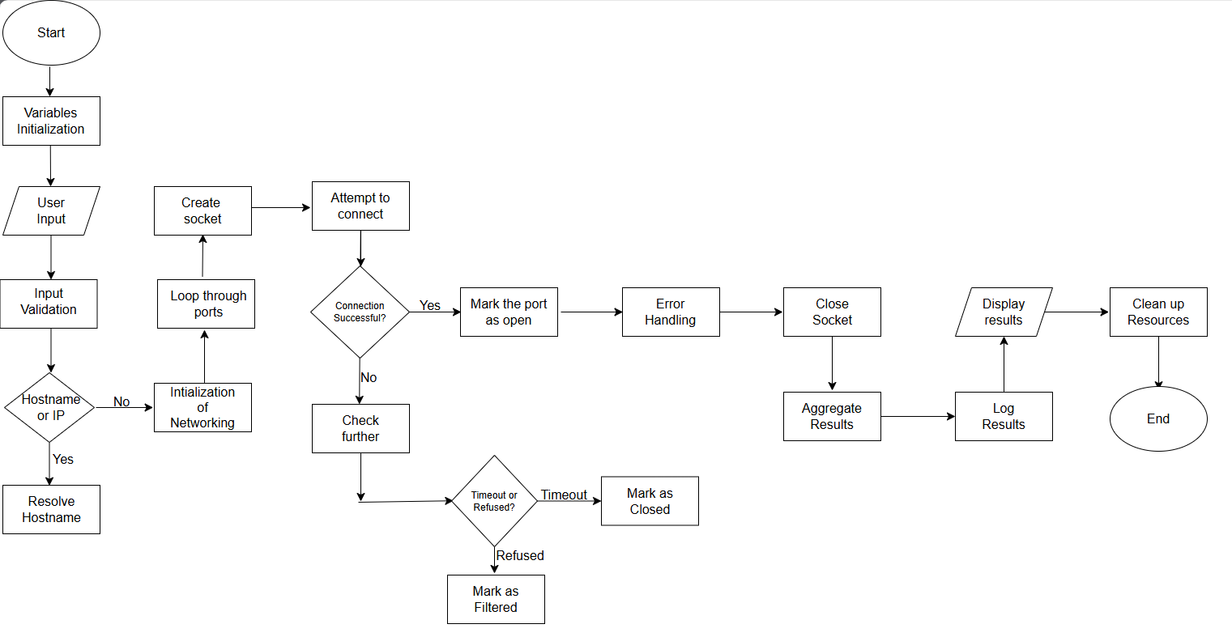
Flowchart of the system
Project Presentation 2024

Slide 11

Implementation Details
Main file of the Network Scanning Tool :-
Project Presentation 2024

Slide 12

Implementation Details
IP Header file :-
Project Presentation 2024

Slide 13

Implementation Details
ICMP Header file :-
Project Presentation 2024

Slide 14

Implementation Details
UDP Structure file :-
Project Presentation 2024

Slide 15
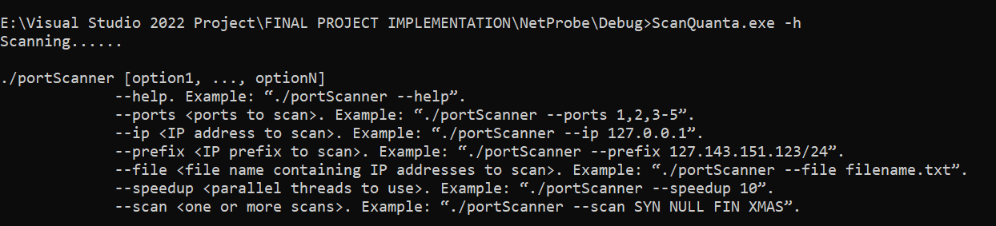
Testing of the Project
Project Presentation 2024

Slide 16

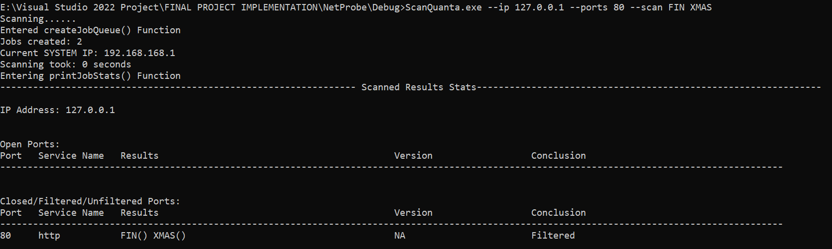
Project Presentation 2023

Slide 17
Conclusion
  Network scanning tools are crucial for organizations aiming to secure their networks and optimize performance. These tools offer various benefits, such as identifying security vulnerabilities, monitoring network traffic, and optimizing resource utilization. They also help ensure compliance with regulatory requirements by facilitating continuous audits. However, despite their advantages, these tools come with certain limitations. False positives can lead to unnecessary investigations, and the tools can be resource-intensive, especially when scanning large networks. Additionally, privacy concerns may arise if scanning is not conducted carefully, potentially infringing on sensitive data or user privacy. Overall, while network scanning tools are essential for maintaining network security and efficiency, it’s important to balance their use with an awareness of their limitations to maximize effectiveness
Project Presentation 2023

Slide 18
Future Work
Implement an intuitive and user-friendly interface for seamless interaction with the network scanning tool.
Integrate real-time data visualization to display scanning results and vulnerabilities in a clear, graphical format.
Enhance accessibility by including customizable settings for users to tailor the scanning options and outputs.
Allow users to manage multiple tasks simultaneously using interactive dashboards and task progress indicators.
Design interactive error handling mechanisms that provide clear alerts and troubleshooting suggestions for detected issues.
Project Presentation 2023

Slide 19
References
Gadge, Jayant and Anish Anand Patil. ”Port scan detection.” 2008 16th IEEE international Conference on networks. IEEE, 2008.
Fuchsberger, Andreas. ”Intrusion detection systems and intrusion prevention systems.” Information Security Technical Report 10.3 (2005): 134-139.
Singh, Gopal, Sachin Goyal, and Ratish Agarwal. ”Intrusion detection using network monitoring tools.” Available at SSRN 2426105 (2014).
Abu Bakar, R., Kijsirikul, B. (2023). Enhancing Network Visibility and Security with Advanced Port Scanning Techniques. Sensors, 23(17), 7541.
Xia, Wenfeng, et al. ”A survey on software-defined networking.” IEEE Communications Surveys Tutorials 17.1 (2014): 27-51.
Li, Ruoshi, Markus Sosnowski, and Patrick Sattler. ”An overview of OS fingerprinting tools on the internet.” Network 73 (2020): 73-77.
Project Presentation 2023

Slide 20
Thank you
Project Presentation 2023

